Slide 1
Data Mining techniques to find the secondary structure of Protein
Samarth Patel(10BCE0328)
Monica P(10BCE0317)
Kumar Sangam(10bce0026)

Slide 2
Project Description
We have proteins made up of amino acids, using the data mining techniques we are trying to find out the secondary structure through which we can predict the diseases which a person may be getting in the future through inheritance by looking at the secondary structure and is very much useful for drug manufacturing.

Slide 3
Aim
The main aim is to accurately predict secondary structure of the protein from its primary structure there by reducing the risk of inherited diseases and would be very much helpful in drug manufacturing.

Slide 4
Objective
The main objective is to predict secondary structure with more accuracy by implementing the Hidden Markov Model combined with KNN.

Slide 5
Applicability
Successful secondary structure prediction provides a starting point for direct tertiary structure modeling and provides necessary information for protein folding resides completely within the primary structure.

Slide 6
Introduction
We have proteins made up of amino acids, using the data mining techniques we are trying to find out the secondary structure by converting the 20 different amino acids present in the sequence into three letter secondary structures as alpha, beta sheet, coil and others, for which amino acid cannot be predicted.

Slide 7
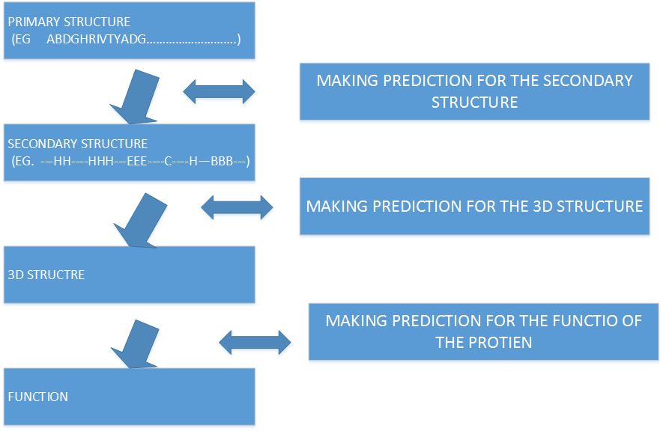
Purpose
In this project we are trying to improve the accuracy of the secondary structure thereby increasing accuracy of the 3-D structure which in turn helps us to determine the exact function of the protein using different data mining algorithms and then trying to combine them with other algorithms for further accuracy.

Slide 8
Scope
Bio molecular structure prediction is the prediction of the three-dimensional structure of a protein from its amino acid sequence, or of a nucleic acid from its base sequence. In other words, it is the prediction of secondary and tertiary structure from its primary structure. Structure prediction is the inverse of bio molecular design. Protein structure prediction is one of the most important goals pursued by bioinformatics and theoretical chemistry. Protein structure prediction is of high importance in medicine (for example, in drug design) and biotechnology (for example, in the design of novel enzymes). Every two years, the performance of current methods is assessed in the CASP experiment.

Slide 9
Problem Statement
Predicting protein structure from amino acid sequence is one of the most important unsolved problems of molecular biology and biophysics. Not only would a successful prediction algorithm be a tremendous advance in the understanding of the biochemical mechanisms of proteins, but, since such an algorithm could conceivably be used to design proteins to carry out specific functions. Prediction of the secondary structure of a protein (alpha-helix, beta-sheet, coil) is an important step towards elucidating its three dimensional structure as well as its function. In this project, we use different Hidden Markov models for predicting protein secondary structure prediction. We have also used K^{th} nearest neighbor for classifying the proteins and there by accurately predicting the secondary structure of the protein. We have used Hidden Markov model with forward algorithm and Viterbi algorithms.

Slide 10
Study of Techniques - Hidden Markov Model
Definition: The Hidden Markov Model (HMM) is a variant of a finite state machine having a set of hidden states, Q, an output alphabet (observations), O, transition probabilities, A, output (emission) probabilities, B, and initial state probabilities, Π. The current state is not observable. Instead, each state produces an output with a certain probability (B). Usually the states, Q, and outputs, O, are understood, so an HMM is said to be a triple, ( A, B, Π ).

Slide 11
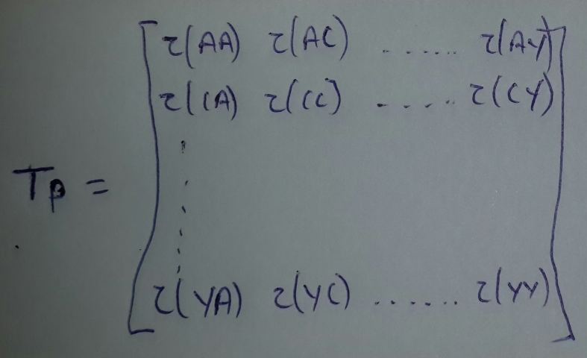
Proposed Methodology - Hidden Markov Transition Matrix
Construction of transition matrices of protein sequences
If a = a₁a₂. . .a_{n} is a given protein sequence, we can regard it as a discrete-time Markov chain. Its state space is S ({A, C, D, E, F, G, H, I, K, L, M, N, P, Q, R, S, T, V, W, Y}), and the movements among the state space S are AA, AR, AN, AD, and so on. If r and t denote a pair of random neighbouring states of the given sequence, the transition matrix (TP) can be defined as follows:
This transition matrix is calculated by finding such pairs in the database. The final condition is that the summation of the whole row should be one and in order to do that we have calculated the total number of pairs for each and then we have divided the each column with the summation of that particular row. The following algorithm is used to find the transition matrix

Slide 12
Algorithm for getting the no. of pairs for each amino acid.
Define two character array consisting of all the twenty amino acid each.
Connect to the database.
Begin i=0….19
Begin j=0….19
Get one row from the database where the protein sequences are stored(ie getting one sequence each time to compare)
Calculate the length of the protein sequence
Begin k=1…length
Check that if k-1 and k are matching to i,j.
If so then, increment the counter.
End k
Update the counter in the database.
End j.
End i.

Slide 13
Algorithm to convert the transition into a unit value
Define two character array consisting of all the twenty amino acid each.
Connect to the database.
Begin i=0….19
Connect to database
Get each column value for a row and add it to the counter and store in an array
End i
Begin j
Connect to database.
Divide each column with the summation value.
Update the value in the database.
End j.

Slide 14
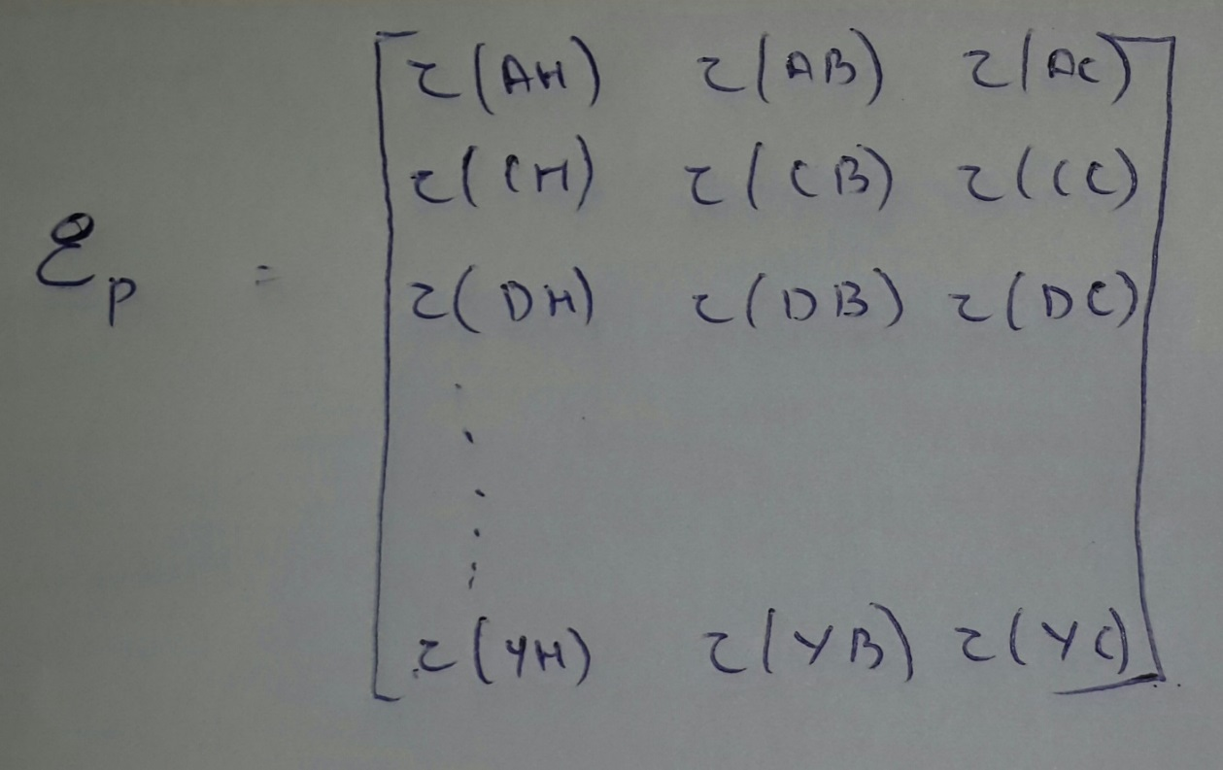
Construction of emissive matrices of protein sequences
If a = a₁a₂. . .a_{n} is a given protein sequence, we can regard it as a discrete-time Markov chain. Its state space is S ({A, C, D, E, F, G, H, I, K, L, M, N, P, Q, R, S, T, V, W, Y}), and the corresponding protein secondary structure P (H,B,C). We are calculating the tendency for an amino acid to be in helix, beta and coil. Comparing the amino acid and its corresponding structure, we will get the number of times helix, beta, coil was present when that particular amino acid was presented. The emissive matrix (EP) can be defined as follows:

Slide 15
Emissive Algorithm
Define two character array consisting of all the twenty amino acid and secondary structure elements.
Connect to the database.
Begin i=0…19.
Initialize counter=0.
Get each protein primary structure and check particular amino acid is present.
If present the get the secondary structure and check if it is H, B, C and increment the counter accordingly.
End i.

Slide 16
Proposed Algorithm
In our proposed algorithm instead of constructing One Hidden Markov model for three states of secondary structural elements. We propose three separate Hidden Markov Models i.e. for every secondary structural element we construct One Hidden Markov Model. Every Hidden Markov Model will give a probability. Out of these three probabilities which Hidden Markov Model is giving maximum probability that becomes the secondary structure of that particular amino acid.
This is how the transition and the emissive values will be assigned for the amino acid ACEG separately for alpha, beta and coil respectively for this amino acid. This is the only for 4 amino, but in the project this will be for all the 20 amino acid transition for one to another.

Slide 17
Forward Algorithm
Initialization:
i=0; f₀(0)=1, f_{k}(0)=0 for K>0
Recursion
F_{l}(i)=e_{l}(x_{i})(∑ f_{k}(i-1) * a_{kl} )
Termination
P(x)= ∑f_{k}(L)a_{k0}
Where
Transition probability a_{kl} = P(π_{i}=l | π_{i-1} = k) is the probability ability of transitioning from state K to state L for K, l ≤≥ Q.
Emission probability, E_{k}(b)= P(x_{i}=b| π_{i} = k), for each state , K, and each symbol b, where E_{k}(b) is the probability of seeing symbol b in state k.

Slide 18
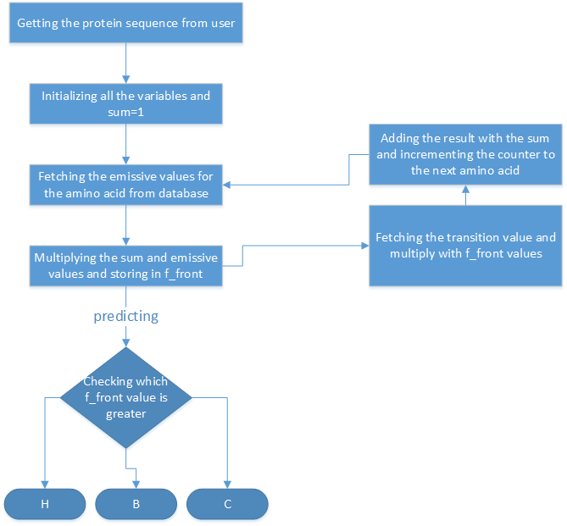
Flowchart of Forward Algorithm

Slide 19
Viterbi Algorithm
Input: x = x₁……x_{N}
Initialization:
V₀ (0) = 1 (0 is the imaginary first position)
V_{k} (0) = 0, for all k > 0
Iteration:
V_{j} (i)= e_{j} (x_{i}) × max_{k} a_{kj} V_{k}(i – 1)
Ptr_{j}(i) = argmax_{k} a_{kj} V_{k}(i – 1)
Termination:
P(x, π*) = max_{k} V_{k}(N)
Trackback:
π_{N}* = argmax_{k} V_{k}(N)
π_{i-1}* = Ptr_{πi} (i)

Slide 20
Underflows are a significant problem
P[ x₁,…., x_{i}, π₁, …, π_{i} ] = a_{0π1} a_{π1π2}……a_{πi} e_{π1}(x₁)……e_{πi}(x_{i})
These numbers become extremely small – underflow
The Solution to such underflow is to take the logs of all values
V_{l}(i) = log e_{k}(x_{i}) + max_{k} [ V_{k}(i-1) + log a_{kl} ]

Slide 21
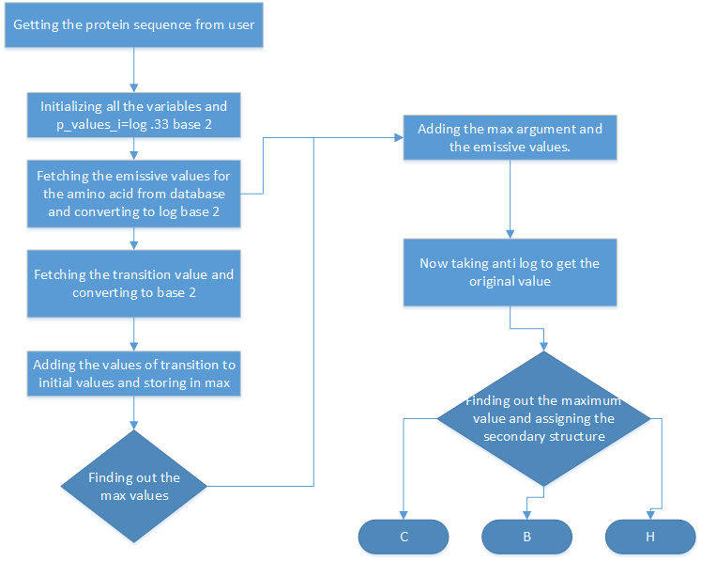
Flowchart Of Viterbi

Slide 22
K^{th} Nearest Neighbor
We implemented K^{th} Nearest Neighbor to classify the proteins and to find the secondary structure and this we have done in three different levels as Level 2, Level 3 and Level 4. In Level 2 we have formed pairs of 2, two adjacent amino acids without repetition, in this level similarly in level 3 formed pairs of 3 and in level 4 pairs of 4 and then these structures obtained by the three different levels are found and the accuracy is found separately for these three different levels.

Slide 23
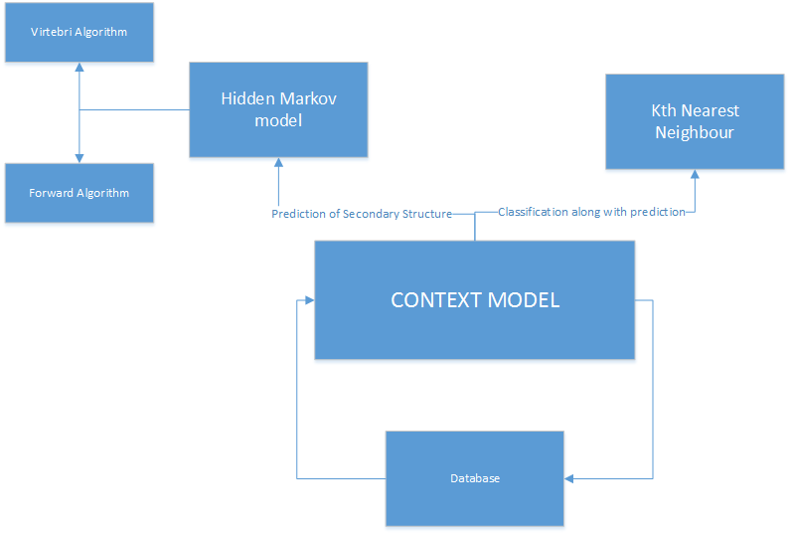
Context Model

Slide 24
Process Model
The process model which will be used is Incremental model as the system needs to be updated very often and features are getting added day by day and as it is a research project it will need a lot to add and a lot of changes may be done Hence we are using incremental model and though, protein database is very vast we cannot use Waterfall Model as we are not yet clear of the complete protein behaviour and research is still going on and when compared to spiral and revolutionary as features are getting added Incremental suits the best.

Slide 25
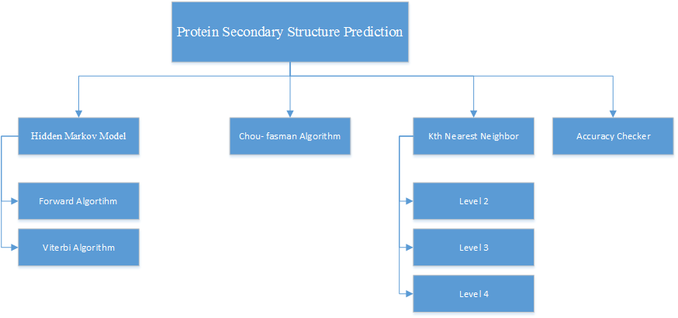
Work Breakdown Structure

Slide 26
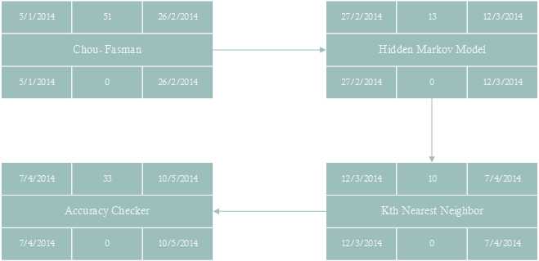
Pert Chart

Slide 27
Stake Holder
User/Administrator
Requirements Stake Holder
The system shall ask the user/Admin to enter a valid protein sequence.
The system shall ask the fasta format for knn.
The system shall require User/Admin to enter equal length of secondary structure for accuracy prediction.
The system shall accept N length protein sequence for prediction.

Slide 28
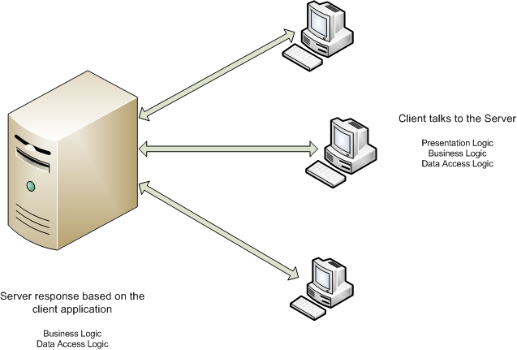
Architecture Diagram

Slide 29
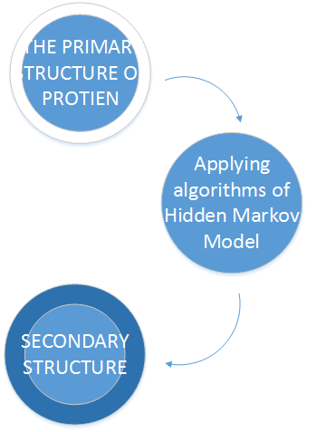
Data Flow Diagram – Level 0

Slide 30
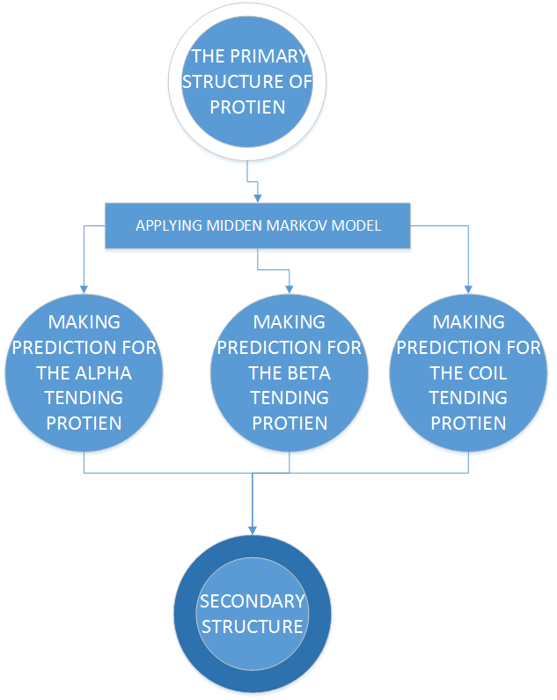
Data Flow Diagram – Level 1

Slide 31
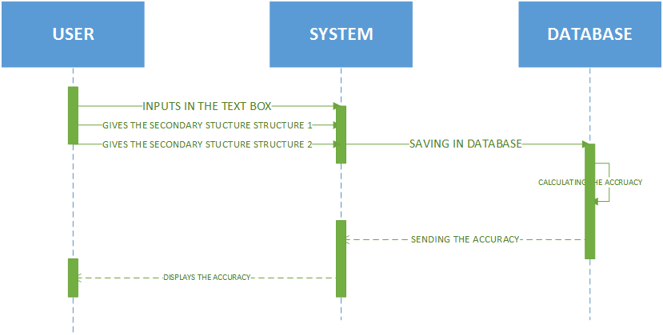
Sequence Diagram – Accuracy Sequence

Slide 32
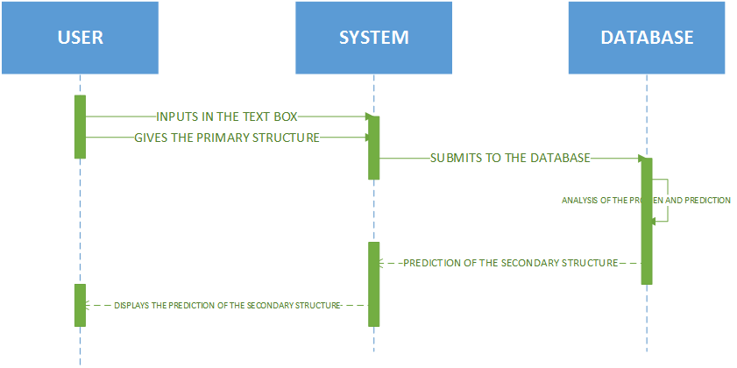
Sequence Diagram – Prediction Sequence

Slide 33
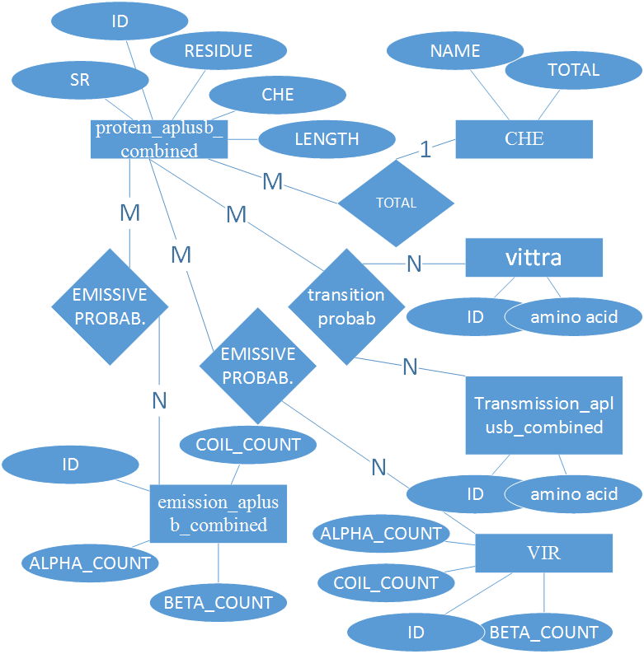
Entity Relation Diagram

Slide 34
Result Analysis
Fasta Format | ForwardAlgorithm | Viterbi Algorithm | Level 2 KNN | Level 3 KNN | Level 4 KNN
3GRS | 54 | 55 | 66 | 95 | 53.2
1ZTE | 62.2 | 64.8 | 70 | 79.7 | 56.08
1A7W | 72.3 | 72.3 | 70.2 | 85.16 | 100
1ABS | 68.75 | 71 | 73 | 91.4 | 91.4
2FP1 | 81.74 | 84.1 | 80.9 | 90.47 | 98.4

Slide 35
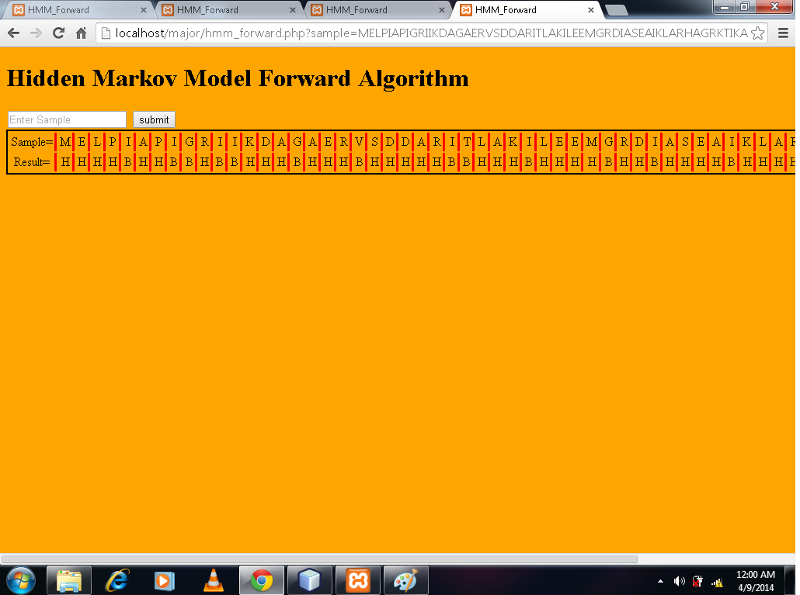
Screen Shots

Slide 36

Screen Shots – Continued…

Slide 37
Verification and Validation
Test case ID | Test Case | Expected Result | Actual Result | Test Outcome
1 | Inputs must be entered | It should show an alert box stating that inputs not entered correctly | Working condition | Passes
2 | Both the proteins entered for accuracy check must be of same length | A prompt message to show length must be same | It is displaying | Passed
3 | If only one input is given it should show need t input both the sequences to check | A prompt message to enter both the sequences | A prompt message to enter both sequences | Passed
6 | Login facility | There should be a username and password for anyone to enter the system | No login available. | Failed

Slide 38
Conclusion
Protein secondary structure plays an important role in the rapidly developing branches of engineering specializing in the study of objects in 3D structure prediction. But many of the researches they have applied probabilistic approach. Some companies have already used various architectures but three layer architectures gives good performance with minimum number of nodes. Association classification breaks the limitations of algorithms built on homological analysis and classic artificial intelligence, such as decision tree and the SVM and by pursuing a different way; it develops, out of rules of association classification. Up to now, for this problem maximum 90% achieved with less similarity. In our opinion, it is time for extensive search for the ways of practical use PSS accuracy and speed consideration are likely to remain important as genomic, proteomic and protein engineering projects continue to generate great challenges and opportunities in this area. The protein 2D structure prediction is one of the most hopeful works in the future.

